Slide 1


Slide 2

The Perfect Storm Scenario
Four strategic areas designed to strengthen the assets of rural communities and utilize opportunities that will not happen again in our lifetime.
Notes:
In the late 1990s, the leaders of the Nebraska Community Foundation, Heartland Center for Leadership Development, RUPRI Center for Rural Entrepreneurship and the Center for Rural Affairs got together to discuss how they could better focus their efforts into a more effective and comprehensive development framework for the communities they serve.

Slide 3
Making the Case
“Economic Development is a choice. It is willed within an economy. Economic Development occurs when local leaders choose to identify, invest in, and develop their list of comparative advantages to enable workers, firms, farms and industries to better compete.”
--Steve Buttress
Notes:
The philosophy of HomeTown Competitiveness is the development of a community is a local responsibility – NOT state and federal agencies. They can be partners, but it’s up to each community to build or lose their economy.
Personally, I got tired of the President’s initiatives or the Governor’s initiatives. Guess what happens every 4 years? Things either stay the same for another 4 years or they change. Everyone is busy trying to “leave their legacy” so the programs that may work for some places get cut or changed. Local organizations spend so much time “chasing the buck” that they forget what they were created to do in the first place. HTC resounded with me for that very reason….it is formed locally, funded locally, controlled locally. Federal and state programs can come and go, but the community decides what works and sticks with it.

Slide 4
Youth
Call them what you wish, they were born between 1977-2002.
The vital ingredient to community survival:
3:1 positive impact upon population
Educated workforce for expanding businesses
Substantial consumers of goods and services
Compelling charitable giving priority
New energy, skills, ideas and resources
Support and use public institutions
Retention of local generational wealth

Slide 5
Youth - The Strategy
Engage them!
Entrepreneurship curriculum and community-based learning available to more youths
Stronger school-community partnerships in place to support shared education and community economic development goals
Notes:
Don’t do things to them or for them….include them NOW. They aren’t going to want to move back to their hometown if their town didn’t care for them when they were growing up.
The number one reason young people state they won’t return is there “are no jobs” These strategies and links to the community not only show the youth there are opportunities for them in rural communities, but place them in regular contact with business and community leaders.

Slide 6
Youth – The Example
Knox County Nebraska:
Thinking Outside the Box Rally
Planned by young people in the community
½ day rally on a Friday morning for 9-11 grade students to include: Keynotes from prominent community leaders, small group interaction with local entrepreneurs and economic developers.
Beginning and end of the rally exercise:
“Put Your Feet Where You Want to Live:
Notes:
Knox County Nebraska – has a population of 9,000 people. COUNTY Population.
They, like every other rural community in Nebraska, had seen a continuous decline in population – especially young people. In order to get youth engaged in HomeTown Competitiveness and the community, they held the rally.
Put Your Feet Where You Want to Live Exercise: At the beginning of the day, the students met in the gym. Nebraska was the center circle. When asked, after getting your education and after “experiencing the world” put your feet where you want to live. Only about 1/3 of the kids went to the middle of the circle. After spending their morning listening to local leaders and talking with people who made their living running their businesses in a rural community…here’s what happened.

Slide 7
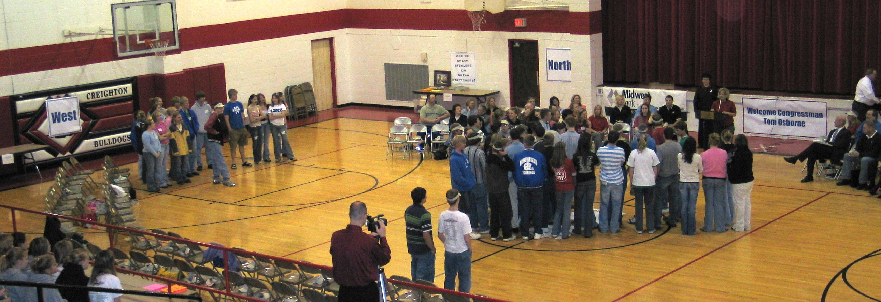
Put Your Feet Where You Want to Live – End of the Rally
Notes:
90% of the students chose Nebraska.

Slide 8
Leadership – The Strategy
Dealing with the 80/20 Rule….
Develops emerging leaders
Expands the pool of volunteers
Expands the leadership skills of current leaders
Creates greater participation – more people willing to do things!
Notes:
We all deal with the 80/20 Rule. Having leadership development in place and a part of your overall economic development plan encourages everyone to bring their assets to the table. We live in a world that is constantly changing and evolving. As Harvard Business School Professor John Kotter wrote, “More change always demands more leadership.” If our communities are not equipped to deal with today’s changing world, what will become of them?

Slide 9
Leadership – The Example
Stuart — Population 680
Atkinson — Population 1244
Eight Miles Apart
Stuart-Atkinson, NE
2004 HTC Leadership Institute
Notes:
In 2004, both communities wanted to start a formal leadership program. The two communities had NEVER worked together on a project EVER. The HTC framers said, “We’ll help, but you must work together.” They had 27 participants ages 16 to 65. Nine one-day sessions from September to May. The number one response at the end of the program – We can work together and build two stronger communities.

Slide 10
Charitable Assets
“Millionaires in the Millennium” Havens & Schervish, 1999, Boston College
What does that mean for rural communities?
retain local wealth
increase philanthropy and build endowments
prevent capital from being a limiting resource to community development – “there’s no money for that”
build sustained community development strategies (by using Asset-Based Community Development, or ABCD)
break out of a cycle of dependency on federal and state grants and tax revenue
Notes:
Study by Boston College tells us there will be a $41 trillion transfer of wealth in the United States in the next 50 years.
Nebraska commissioned a study and they discovered there will be a $94 transfer of wealth before 2050 – with the peak happening sometime around 2015.
This is an unprecedented opportunity for rural communities.
Give the funeral example.
Give 5% to the community you love.

Slide 11
Charitable Assets – The Numbers
Michigan’s Study:
Commissioned by the Council of Michigan Foundations
and Midwest Community Foundations Ventures
The 50-year estimate for Michigan is:
$972.24 billion
The number before 2015 is:
$140.62 billion
Notes:
972 billion in wealth transfer. If we can encourage people to give that 5% - the numbers with the 2015 figure are as follows: an estimated $7.03 billion fund would be realized, and assuming a conservative 5% payout rate on the $7.03 billion in endowed funds, an estimated $351.56 million would be available annually for community betterment investments. To give you an idea of what that can fund: on an annual basis, that’s enough to support the following state departments: Executive, Legislative, History Arts & Libraries and Military and Veterans Affairs. However, these endowments will be in the hands of the local communities
Local examples later…..

Slide 12
Charitable Assets – The Strategy
Strategic Grantmaking to support HTC:
Non-Traditional Scholarships
High-quality affordable day care
Microenterprise Loan Program
Build Leadership with a Purpose
Retaining and recruiting volunteers
Value-added curriculum for K-12 schools

Slide 13
Charitable Assets – The Example
Holt County, Nebraska
O’Neill Community Foundation (pop. 3,733)
$50,000 challenge grant to build unrestricted endowment
50+ $1,000 Founding Members for HTC endowment
$2,000,000+ expectancy for endowment to support area-wide HTC activities
Grant Making to support entrepreneurship training, county-wide leadership class, non-traditional scholarships and HTC coordinator
Notes:
Their strategy with $50,000….it’ll be easier to find 50 people who can give you $1,000. The group that started HTC – 10 people met one night and they all wrote checks for $1,000.

Slide 14
Entrepreneurship
Two More Opportunities….
(1) Generational:
The Whippersnappers
&
The Boomers
(2) Freedom of Location:
The Internet
Notes:
Generation Y, the Millenia Generation, Generation E,
We are at the cusp of another revolution as these two generations come together to shape the new economy.
The Whippersnappers want a life/work balance like no other. They want opportunity and they want it on their terms.
The Boomers want to retire in non-traditional ways. They are not depending on social security – even though the first boomer filed on October 15 to receive benefits this month.

Slide 15
Entrepreneurship – The Strategy
Identify and Assess the Talent
Entrepreneurship Curriculum K-12, Community Colleges
Provide Support:
  Incubators
  Micro Enterprise Development
  SBTDC
  Enterprise Facilitation®
  Informal Customized Assistance
  Facilitate Networks, Peer Groups, Mentorships

Slide 16
Entrepreneurship – How It Fits
Business development creates jobs and new wealth in the community
Assists in retaining existing businesses
Creates career opportunities for youth
Entrepreneurs can provide leadership and new ideas for the community’s development
Notes:
And….entrepreneurs, as a group, are the most philanthropic of all “types” of wealthy people.

Slide 17
Entrepreneurship – Examples
The Nebraska Example
Valley County – Population 5,000
1999 – No Game Plan or Program in place
2006 – $80 Million in New Investment
  80 New Jobs
  Business Transition
  Linked People Recruitment
  Youth Strategy

Slide 18
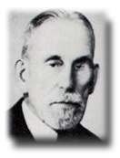
Entrepreneurship – Examples
The Michigan Examples
William E Malpass
East Jordan Ironworks
Notes:
How is this HomeTown Competitiveness? In 2006, the William E Malpass Fund in the Charlevoix County Community Foundation granted out over $96,000 in local grants to the community.

Slide 19
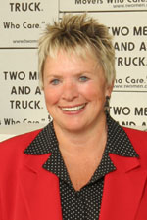
Entrepreneurship – Examples
The Michigan Examples
Mary Ellen Sheets
Two Men and a Truck
Notes:
In 20 years, she has taken the after school job of her sons and turned it into an international company. As an entrepreneur, she also serves on several boards of directors in the Lansing area – including the Michigan Chamber of Commerce, Sparrow Hospital and the Capital Region Community Foundation and supports many local charities. Oh, and guess who after getting their education and “experiencing the world” has come back to their hometown to run the business? Her two sons and daughter!

Slide 20
Branch County’s
HomeTown Competitiveness
The launch – October 2006
The organizations:
Chamber of Commerce
Branch County Community Foundation
Branch County Economic Growth Alliance
Coldwater Downtown Development Authority
Notes:
We went looking for a leadership training program. We came home with a little more in mind.

Slide 21
Branch County’s
HomeTown Competitiveness
Youth
Lesson #1 – You have to go to them
Lesson #2 – You have to include them
Success – Career Day
Notes:
Between sports and extracurricular activities – today’s youth are virtually unavailable. We’ve had one community wide meeting that 100 young people were invited to….15 showed up. In early 2008 we will be visiting local schools during the day to give HTC presentations and get youth involved.
Already were doing some HTC activities – Career Day example

Slide 22
Branch County’s
HomeTown Competitiveness
Leadership
Launching formal leadership program in Fall 2008.
Organizations working together.
Economic Summit – February 29, 2008

Slide 23
Branch County’s
HomeTown Competitiveness
Charitable Assets
Over $11,000 currently in endowment fund.
Branch’s 50 Year Transfer of Wealth Number:
$3.63 Billion
Branch’s 2015 Transfer of Wealth Number:
$560 Million
Organizations working together.
Notes:
That $560 Million Dollars equates into a $28 Million Dollar endowment fund with approximately 1.4 million each year to the local community.
How are organizations working together? For the first time ever, charitable organizations in the community are teaming up. Together, we realize that the money will benefit everyone if it stays locally. For example, if the Tibbits Opera House were to receive a large bequest as a part of the transfer of wealth, that’s one less grant the community foundation has to give. If the Economic Growth Alliance were to receive a large bequest, that’s less of a burden on local tax dollars to fund Economic Development.

Slide 24
Branch County’s
HomeTown Competitiveness
Entrepreneurship
Succession Planning Workshops
Jack Schultz, “BoomTown USA”
Projects in the works include:
One-Stop Information Center
Youth Expo
Alumni “Linking”
Notes:
In a market study conducted in 2006, Branch County discovered 51% of our businesses are owned by someone 50 years or older. In order to ensure those businesses to remain thriving and successful, we need to assist our business owners in transition/succession planning.
Jack Schultz came to town in August of 2007 to see the sights and speak to a group of over 100.

Slide 25
Finally….
Questions?

